Slide 1
Interpreting and visualizing metaG data using R
Bob Danczak
Computational Scientist
Ecosystem Science
PNNL

Slide 2
What is metagenomics?
Throughout this summer school, we’ve already explored metagenomics but let’s refresh our memory!
Metagenomics | Metatranscriptomics | Metaproteomics | Metabolomics
Sequencing extracted DNA | Sequencing RNA via reverse transcribed cDNA | Mass spectrometry-based protein sequencing | Using MS or NMR to identify carbon compounds
Who is there and what could they do | What are they doing | What they are doing | What are they eating/generating
No activity | RNA can be hard to work with | Depth and databases may be an issue | Complements activity measurements
What?
Why?
Why
Not?
These methods have excellent complementarity and fit into the same workflow

Slide 3
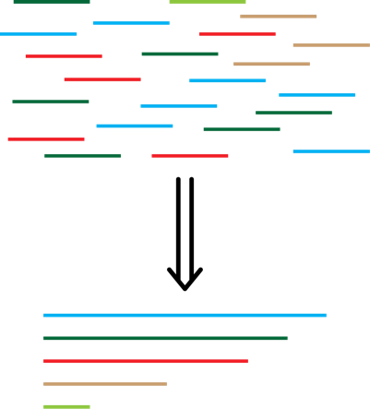
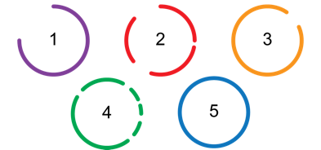
A general multi-omics workflow
Assembly
Binning
metaG Reads
Contigs
Covered during Day 2
Annotation
MAGs
ADH
?
gltA
Annotation
Functional Annotation
Map
Relate
metaT Reads
metaP Data
Interpretation

Slide 4
A general multi-omics workflow
Assembly
Binning
metaG Reads
Contigs
Covered during Day 2
Annotation
MAGs
ADH
?
gltA
Annotation
Functional Annotation
Map
Relate
metaT Reads
metaP Data
We are going to focus on this portion!
Visualization

Slide 5
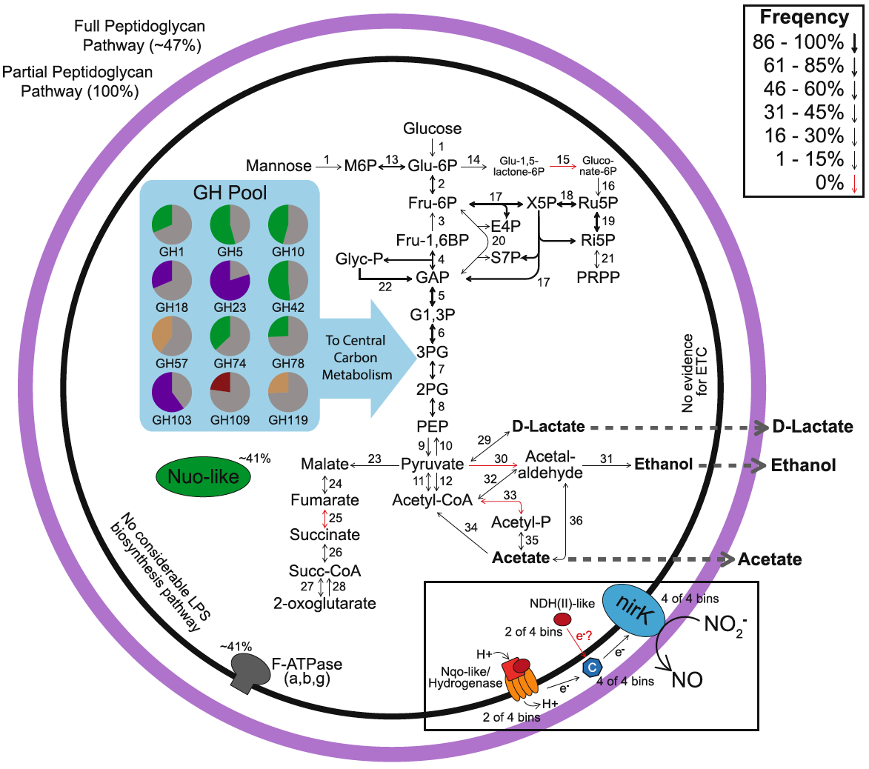
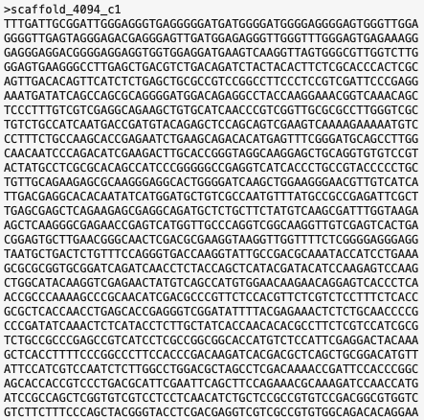
Metagenomic data is dense and needs to be visualized
Parsing metagenomic data is an important pre-requisite in taking sequence data to make more informative or statistical statements
Throughout this talk, try to keep in mind the message each figure is trying to convey
Danczak et al., 2017 – Microbiome

Slide 6
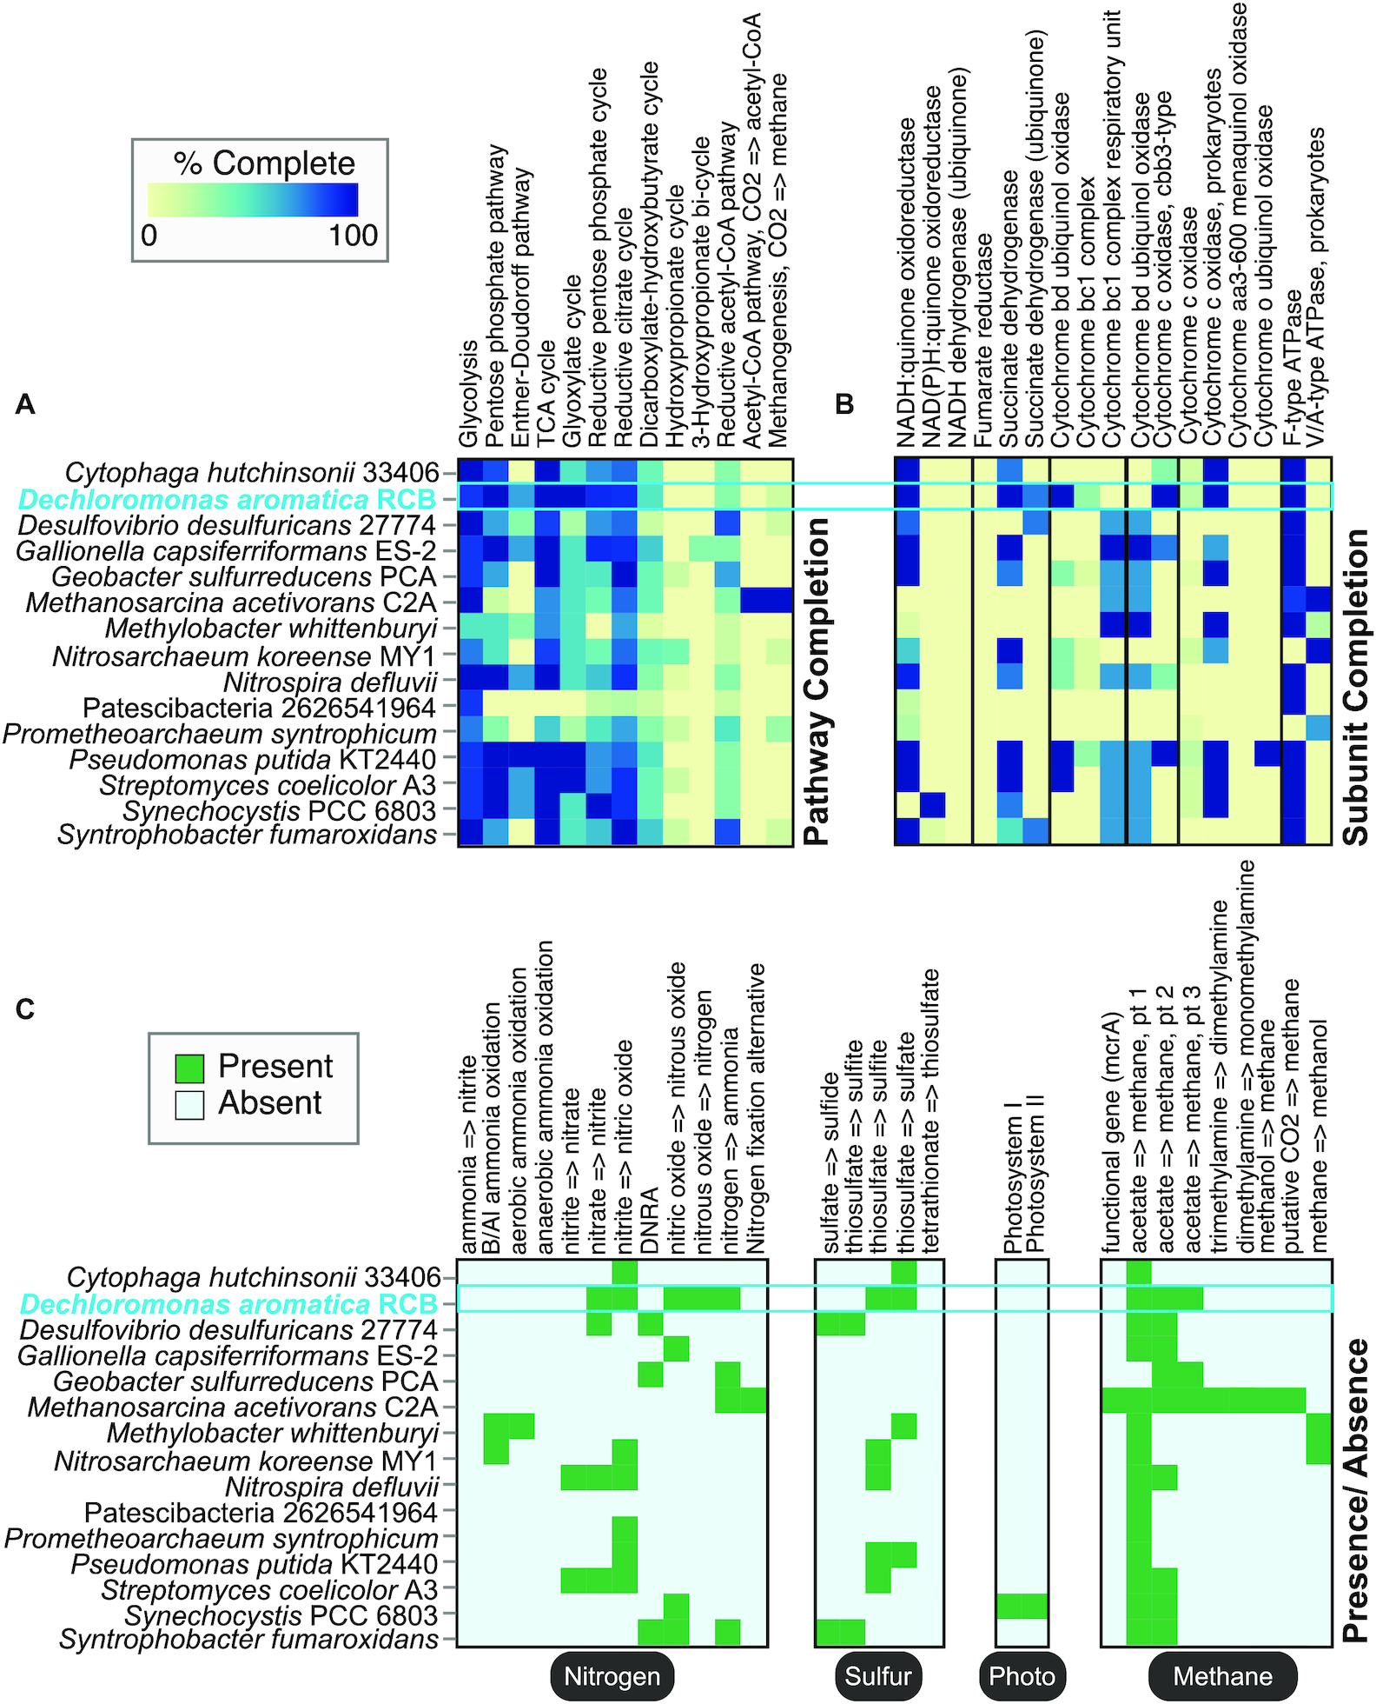
DRAM – a tool for annotation with robust visualization options
DRAM will generate some visualizations automatically
The outputs can also be used to customize your own visualizations
This figure is examining the completeness or presence of different functions within genomes
Shaffer et al., 2020 – Nucl. Acid. Res.

Slide 7
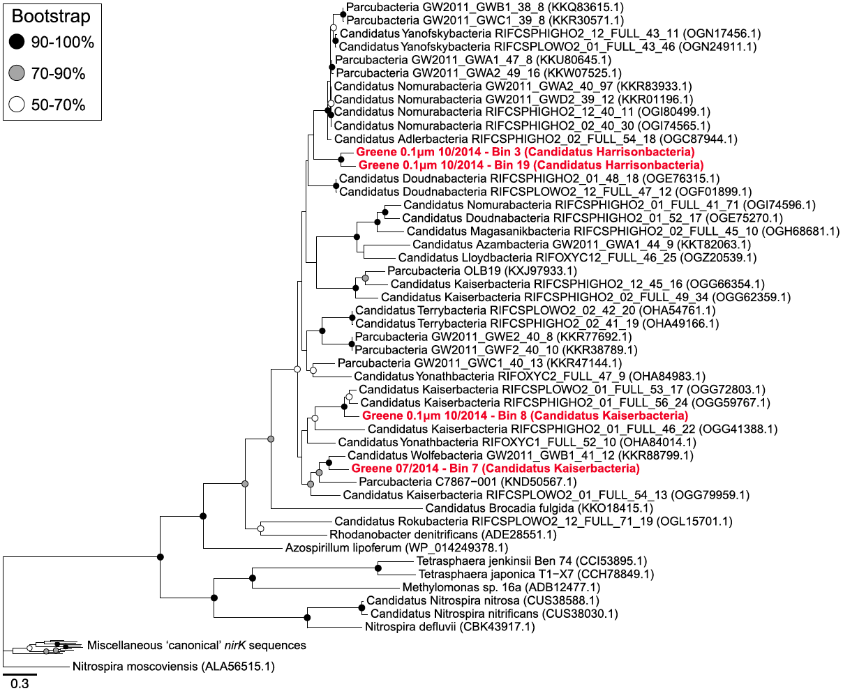
Phylogenetic visualization can help reveal evolutionary patterns
By selecting a gene (or cohort of genes) and performing an alignment and tree generation, we can identify evolutionary relationships
This phylogenetic tree shows that novel nirK sequences are not only conserved within a given lineage, but also are related to known functional variants
Novel nirK sequences
All Parcubacteria
Known, functional nirK sequences
Danczak et al., 2017 – Microbiome

Slide 8
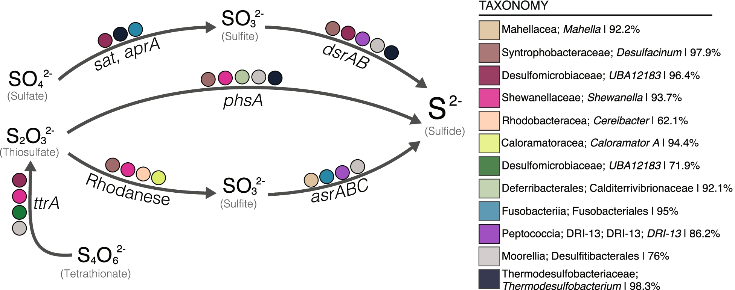
Target specific pathways or genetic targets
By targeting specific pathways or genes, we can identify potential patterns
Within a fractured shale ecosystem, researchers identified that sulfur reduction steps were distributed across the community
Amundson et al., 2022 – Microbiome

Slide 9
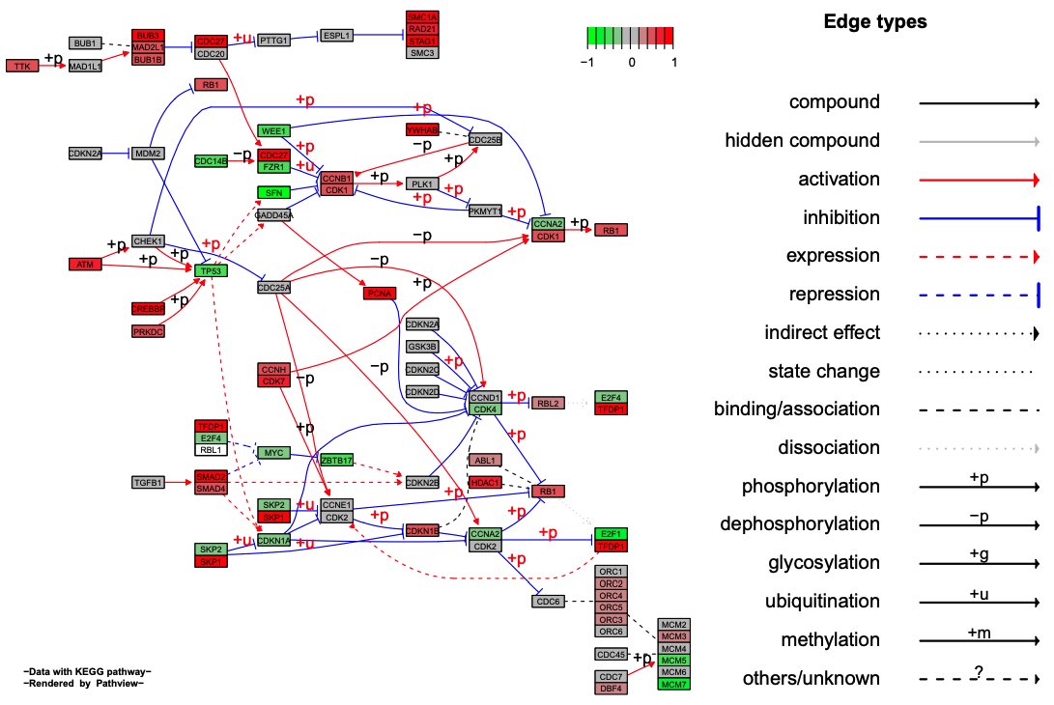
Pathview – An R package that can plot results against KEGG maps
Pathview is a customizable R package that can display multi-omic data and can combine data from various sources to display KEGG pathways
https://github.com/datapplab/pathview

Slide 10
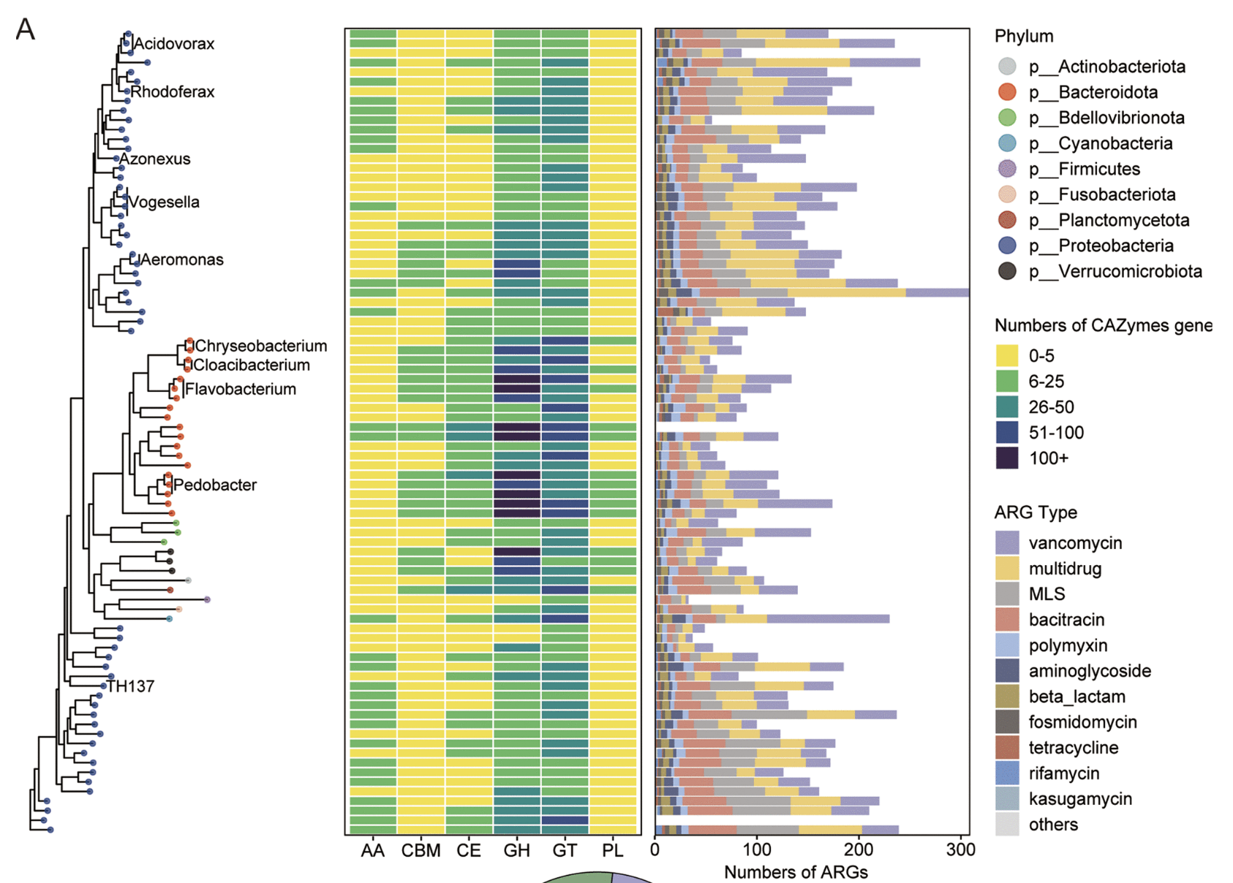
Combining information into one graph can yield great results
ggtree, another R package, can help provide excellent visualizations that convey numerous messages simultaneously
Du et al., 2022 - mSystems

Slide 11
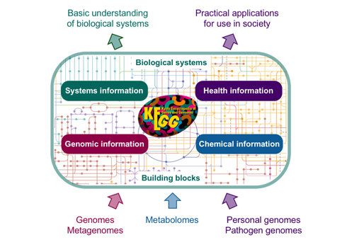

Let’s walkthrough two specific visualization approaches
We are going to walkthrough two visualization and interpretation approaches
Using pre-prepared R scripts and data hosted on GitHub:
We are going to use Pathview to examine the differential presence of carbon and nitrogen processing genes
We are going to track specific nitrogen genes and identify statistical differences across
Goal: These walkthroughs should give you ideas of how to display your omics data and provide a jumping off point for future analyses

Slide 12
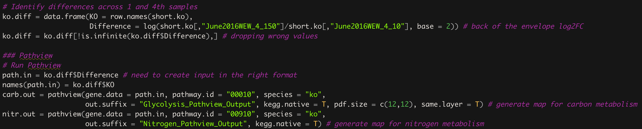
How does Pathview work?
Pathview functions by using KEGG orthology identification numbers (KO numbers) to map to KEGG pathways
For example, K00001 corresponds to alcohol dehydrogenase and would be mapped to, among other pathways, carbon metabolism.
Pathview has a lot of options, but many of the default settings are useful in identifying points in pathways which are differentially abundant/regulated
Fold change between deepest and shallowest depth
Running Pathview
The inputs are straightforward – a list of differential abundance values named after their associated KO numbers

Slide 13
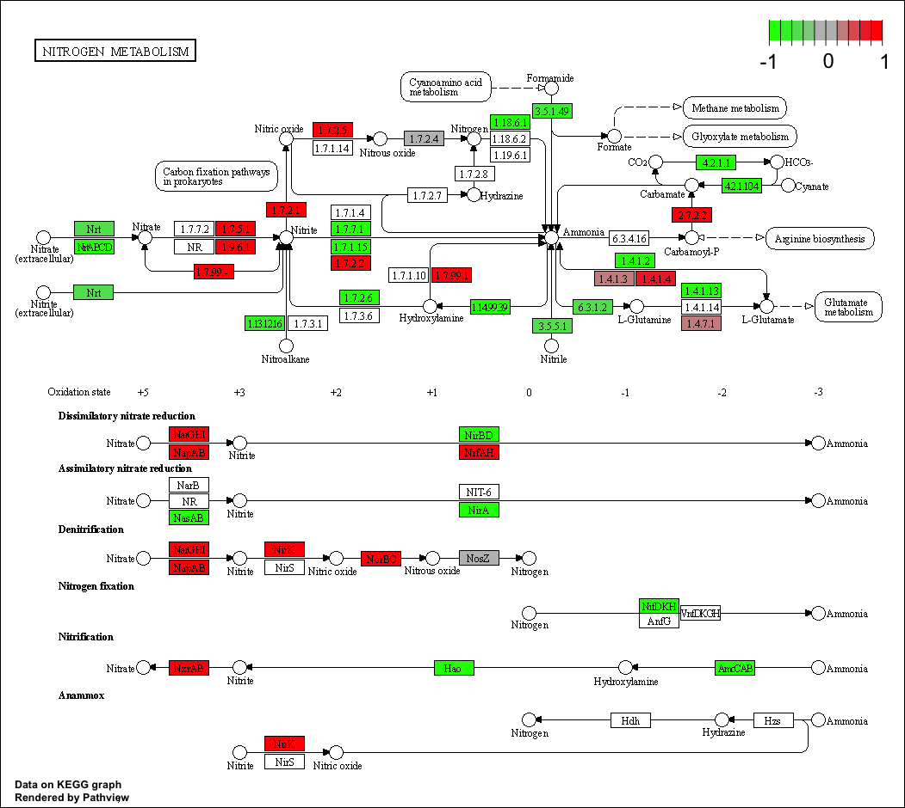
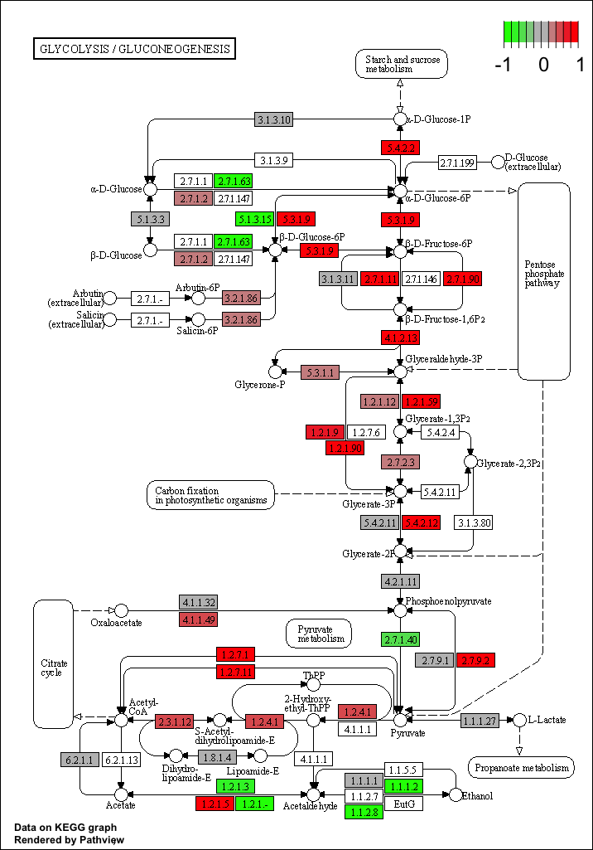
What do our Pathview results look like?

Slide 14
What do our Pathview results look like?

Slide 15
What do our Pathview results look like?
Let’s look at these nitrogen genes more closely

Slide 16
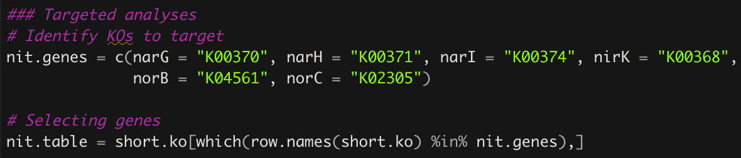
Which genes are we targeting?
It looks like there are a lot more copies of narGHI, napAB, nirK, and norBC are present in the deepest depth than the shallowest depth – this makes them good targets for specific analyses
Given our data is in KO format, we need to convert these gene names:
By going to KEGG and finding these genes and identifying their KO numbers, we can convert between data types are perform some more in-depth comparisons

Slide 17
Let’s look at the comparisons of the four samples we selected
Here we can see some substantial variability across all the samples
Particularly, the sample from the shallowest depth appears to have fewer copies of every gene
Unfortunately, this graph doesn’t provide much insight into the overarching patterns
Let’s take a lot at a comparison using every sample that we have…

Slide 18
Comparisons grouped by depth and plot
By grouping the data by sampling depth or the location from which they were collected, we can observe patterns more distinctly and run statistics
From this graph, it is evident that the shallowest depth (10) has the fewest copies of each gene
There doesn’t seem to be consistent patterns in across locations

Slide 19
Closing Statements
Potential next steps in the analysis:
Convert Pathview plots into genome cartoons to highlight MAG resolved functional variation?
Perform post-hoc tests (e.g., Mann Whitney U tests) for the depth-based analyses to identify differences?
Go down a completely different path and analysis narG phylogeny?
Hopefully, this provided some starting ideas for taking sequence data to plots
Please feel free to reach out if you have questions or need help!
All of this content will remain on GitHub for future reference

Slide 20
Thank you!

